Slide 1
Fermat / AMC 12B
Unofficial Solutions

Slide 2
Problem 23. Three people share a motorcycle to reach a destination 135km away. Two people can ride a motorcycle at a time. If the speed of the motorcycle is 90 km/h and walking speed is 6 km/h, what’s the minimum of time it can take for all three people to get to the destination?

Slide 3
Problem 24. Four numbers satisfy $w<x<y<z$. If the four smallest pairwise sums are 1, 2, 3, 4, then what is the sum of all possible values of $z$?

Slide 4
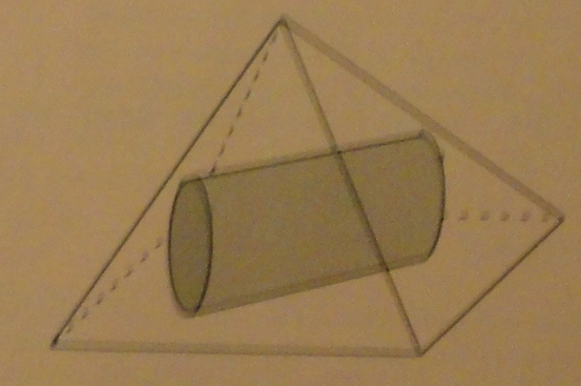
Problem 25. The square pyramid has side length 20; the cylinder has diameter 10 and length 10. If the cylinder is completely inside the pyramid, what’s the smallest possible height of the pyramid?

Slide 5
Problem 10. Rectangle ABCD has AB = 6 and BC = 3. Point M is on AB such that AMD = CMD; find AMD.

Slide 6
Problem 11. A frog starts at (0,0) and makes jumps of length 5 and always lands on points with integer coordinates. How many jumps are needed to get to (1,0)?

Slide 7
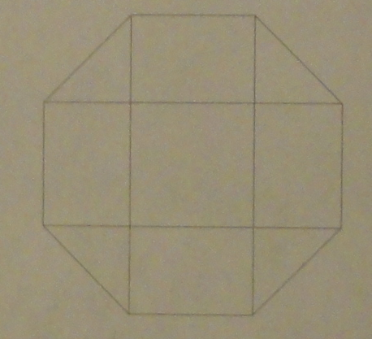
Problem 12. A dart is thrown at a regular octagon. What is the probability that it will land in the center square?

Slide 8
Problem 13. Four integers $w>x>y>z$ has sum 44. The pairwise differences are 1, 3, 4, 5, 6, 9. What is the sum of all possible values of $w$?

Slide 9
Problem 14. A segment through the focus F of parabola with vertex V is perpendicular to FV and intersects the parabola at A and B. What is cos(AVB)?

Slide 10
Problem 15. How many two digit integers are factors of $2^{24}−1$?

Slide 11
Problem 16. Rhombus ABCD has side length 2 and B = 120. What is the area of the region R containing all points closer to B than any other vertex?

Slide 12
Problem 17. Let $f\left(x\right)={10}^{10x}$, $g\left(x\right)=\log_{10}{\frac{x}{10}}$, $h_{1}\left(x\right)=g(f\left(x\right))$, and $h_{n}\left(x\right)=h_{1}(h_{n−1}\left(x\right))$; find the sum of digits of $h_{2011}(1)$.

Slide 13
Problem 18. A square pyramid has base 1 and has equilateral faces. A cube in the pyramid is placed so one side touches the base and the opposite side has all its edges on the faces of the pyramid. What is the volume of this cube?

Slide 14
Problem 19. The graph of $y=mx+2$ passes through no lattice point with $0<x≤100$ for all $m$ such that $\frac{1}{2}<m<a$. What is the maximum possible value of $a$?

Slide 15
Problem 20. Triangle ABC has AB = 13, BC = 14, AC = 15. Points D, E, F are midpoints of AB, BC, AC respectively. Let X be the intersection of the circumcircles of BDE and CEF. What is XA + XB + XC?

Slide 16
Problem 21. The arithmetic mean of two positive integers x and y is a two digit integer, and the geometric mean is the reverse of the arithmetic mean. What is |x-y|?

